Slide 1
Haldi
Gurduut
PPT for Event ID: 14
Date: 2025-02-27

Slide 2
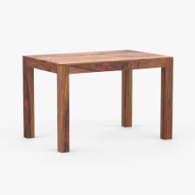
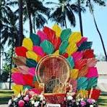
Category: Furniture
table
chair
₹200.00 x 3
₹500.00 x 1

Slide 3
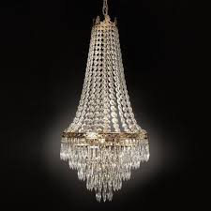
Category: Decor
Jhoomar
₹2000.00 x 4

Slide 4
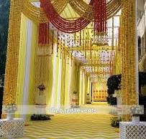
Category: Entrance
Haldi Entrance
₹30000.00 x 1

Slide 5

Category: Services
Russian Dancer
₹6000.00 x 12

Slide 6
Quotation Summary
Total Cost: ₹111100.00

